Slide 1
PROJECT REPORT BY->TEAM C
TEAM MEMBERS
HAREESh hm
Shazia begum
REKHA P
MOHAN KUMAR V
MENTOR : NAGARAJ SIR

Slide 2
PART 1
EXPENSE DETAILS FOR THE MONTH OF JUNE
Expense Details for the month of June
Date | Category | Items | Expense (INR)
2-Jun | Grocery | Foodgrains and cereals | 1,050
2-Jun | Grocery | Oil and spices | 550
2-Jun | Entertainment | Movie | 250
3-Jun | Food | Online Food Order | 150
3-Jun | Doctor and Medicine | Mother's Medicine | 450
4-Jun | Ticket and Bills | Railway monthly ticket | 350
6-Jun | Grocery | Vegetables | 450
6-Jun | Grocery | Fruit | 150
8-Jun | Food | Chips and Fries | 100
9-Jun | Grocery | Bread and bakery | 100
10-Jun | Shopping | Shoes | 1000
11-Jun | Grocery | Vegetables | 250
12-Jun | Food | Online Food Order | 100
12-Jun | Entertainment | Movie | 250
13-Jun | Grocery | Beverages | 250
13-Jun | Ticket and Bills | House help | 1000
14-Jun | Ticket and Bills | Electricity bill | 370
15-Jun | Ticket and Bills | Gas | 850
15-Jun | Grocery | Fruit | 200
16-Jun | Grocery | Vegetables | 470
19-Jun | Miscellaneous | Sister's birthday gift | 500
19-Jun | Grocery | Bread and bakery | 200
20-Jun | Food | Chips and Fries | 150
22-Jun | Food | Online Food Order | 150
23-Jun | Entertainment | Movie | 250
24-Jun | Grocery | Vegetables | 250
25-Jun | Shopping | Tshirt and Jeans | 2500
26-Jun | Grocery | Fruit | 200
26-Jun | Grocery | Bread and bakery | 200
27-Jun | Entertainment | Movie | 250
28-Jun | Food | Online Food Order | 200
29-Jun | Grocery | Fruit | 100
29-Jun | Grocery | Vegetables | 270

Slide 3
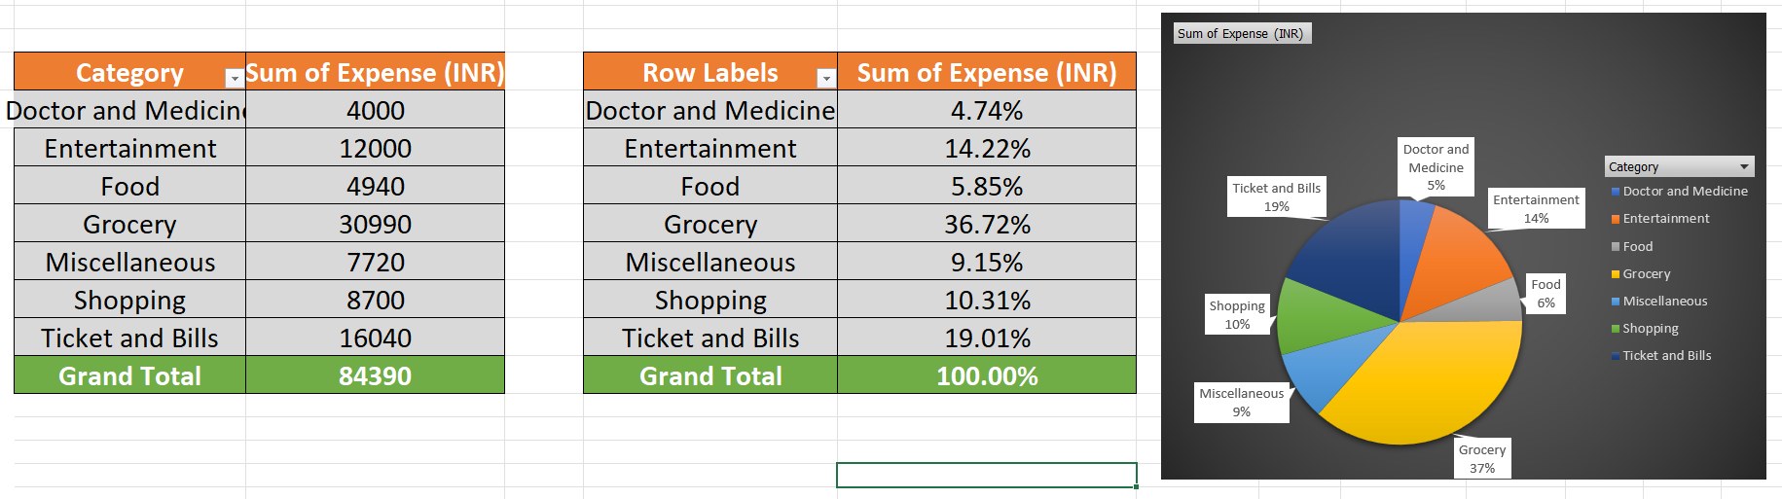
1)How much is spent for each category (Pivot Table)
2)Visually represent the amount spent against each category is what percentage of the total expense amount (Pivot Chart)

Slide 4
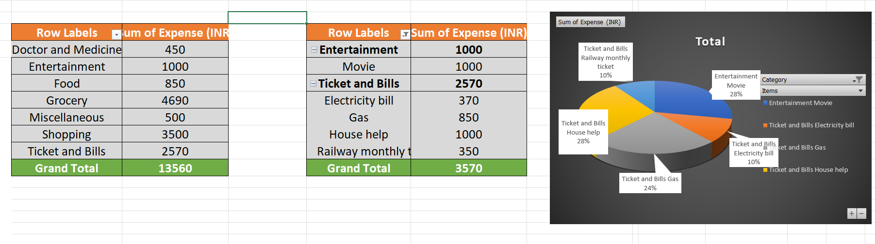
1)How much is spent on different items of each category (Pivot Table)
2)Visually represent the amount spent on different items of Entertainment and Tickets and bills category (Pivot Chart)

Slide 5
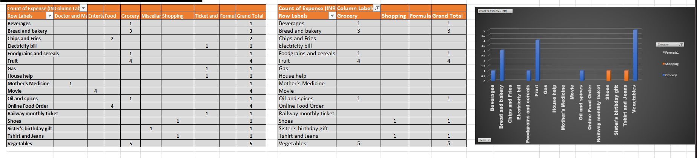
1)How many times money has been spent against different items of each category (Pivot Table)
2)Filter the data to display the data for Grocery items and Shopping items

Slide 6
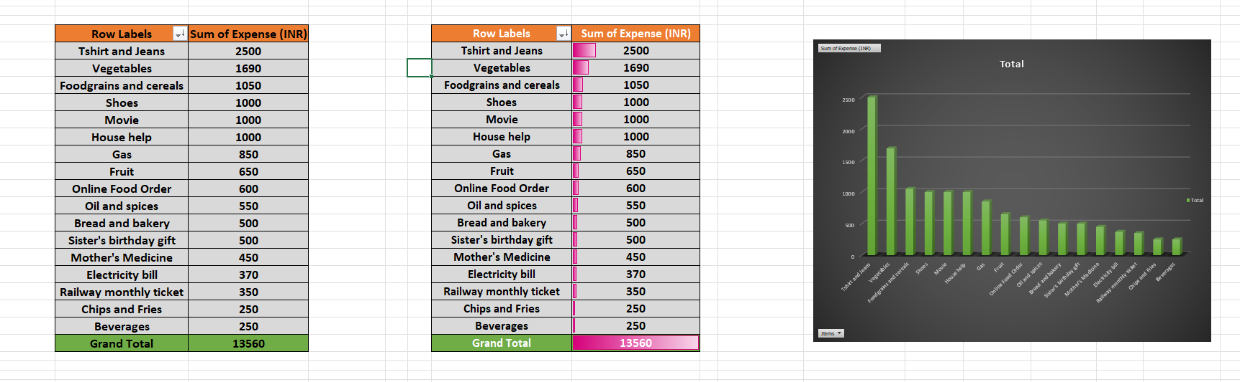
1)What amount is spent on each item of the categories with highest and 2nd highest expense amount (Pivot Table)
2)Visually represent the data with data bars (Conditional formatting)

Slide 7
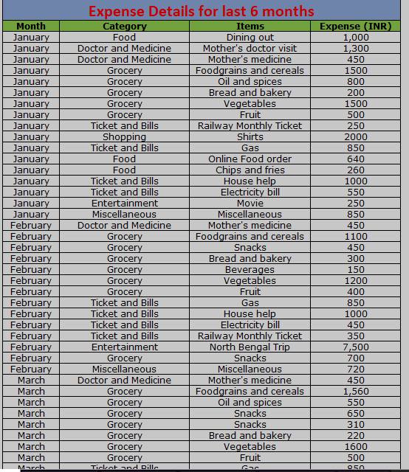
EXPENSE DETAILS FOR LAST 6 MONTHS
Part 2

Slide 8
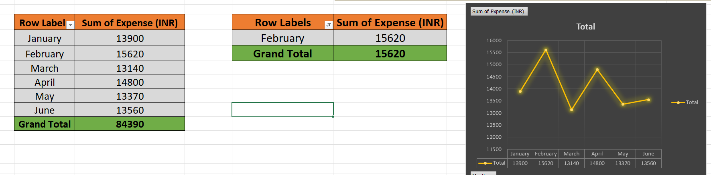
1)Month-wise trend of expenses (Pivot table and chart)
2)Find out the month Nitin spent the most

Slide 9
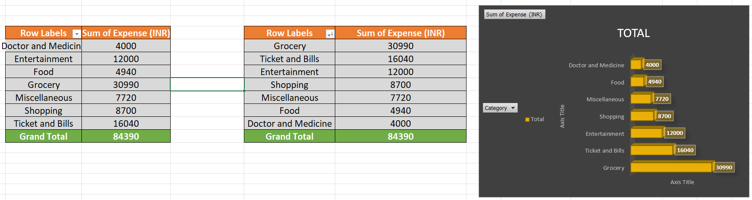
1)Category wise expenses (Pivot table)
2)Visually represent it with data bars to display categories with the highest and lowest expense amount

Slide 10
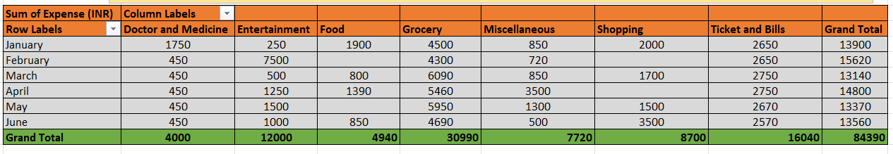
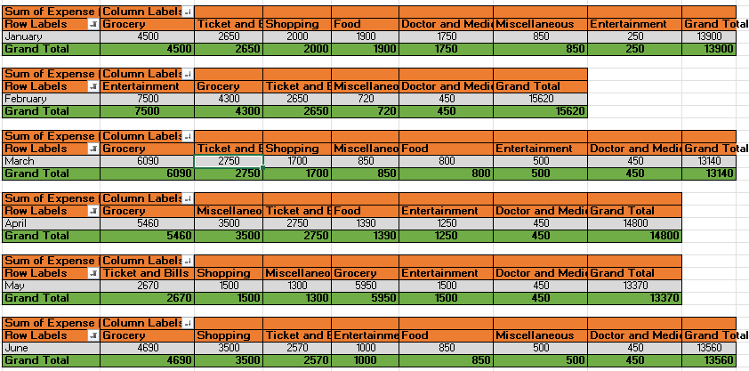
1)Month-wise expense of each category (Pivot table)
2)Find out 2 categories with higher expenses for each of the 6 months

Slide 11
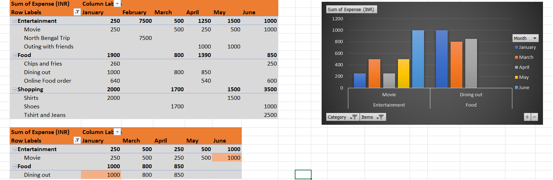
1)How much is spent in each month against different items of Entertainment, Food and Shopping categories (Pivot table)
2)Find out which months have the highest amount spent for movies and dining out

Slide 12
1)Decide on the essential and less essential items and analyse the expenses
2)Recommend how can Nitin increase his savings
 | ESSENTIAL ITEMS
 | Doctor and Medicine: Mother's doctor visit and medicine expenses are essential for health.
 | Grocery: Foodgrains, cereals, oil, spices, bread, bakery, vegetables, and fruits are essential for daily meals.
 | Ticket and Bills: Gas, house help, electricity bills, and railway monthly ticket are necessary for daily living and transportation.
 | Less Essential Items:
 | Shopping: Shirts, shoes, t-shirts, jeans - These are considered less essential.
 | Entertainment: Movie expenses, trips, outings with friends - While these contribute to well-being, they are less essential.
 | Food (Non-Grocery): Online food orders, dining out, chips, fries - These could be considered less essential.
 | Miscellaneous: Items like brother's tuition fee, sister's birthday gift - These may vary in essentiality based on personal priorities.
 | Nithin can increase his savings by :
 | Budgeting
 | Cutting non-essential expenses such as dining out, Entertainment, unnecessary shopping.
 | Go with low-cost plans on bills of cable , internet
 | energy-efficient practices at home to reduce utility bills.

Slide 13
THANK YOU….

